Slide 1



hotels
View in Power BI
Last data refresh:
10/26/2022 12:43:30 PM UTC
Downloaded at:
10/31/2022 4:10:21 PM UTC

Slide 2


Slide 3

Introduction
The hotel industry is one of the most important components of the wider service industry, catering for customers who require overnight accommodation. The tourism and travel industries like hospitality, cruising, theme parks, etc., have different requirements and particularities that cannot be fully explored without industry’s specific data.
This data set contains booking information for a city hotel and a resort hotel, and includes information such as when the booking was made, number of cancellations, length of stay, the number of adults, children, type of customers, among other things.

Slide 4

Objective
Here we attempt to find insights from the given data set using Microsoft Power BI to understand booking patterns, cancellations and thereby maximize profit.

Slide 5

Features
Hotel
Is canceled
Lead time
Arrival date year
Arrival date month
Arrival date
Week number
Arrival date day of month
Stays in weekend nights
Stays in week nights
adults
children
babies
meal
country
Market segment
Distribution channel
Is repeated guest

Slide 6

Features
previous cancellations
previous bookings not canceled
Reserved room type
Assigned room type
Booking changes
Deposit type
agent
company
Days in waiting list
Customer type
Average daily rate
Required car
Parking spaces
Total of special requests
Reservation status
Reservation status date

Slide 7
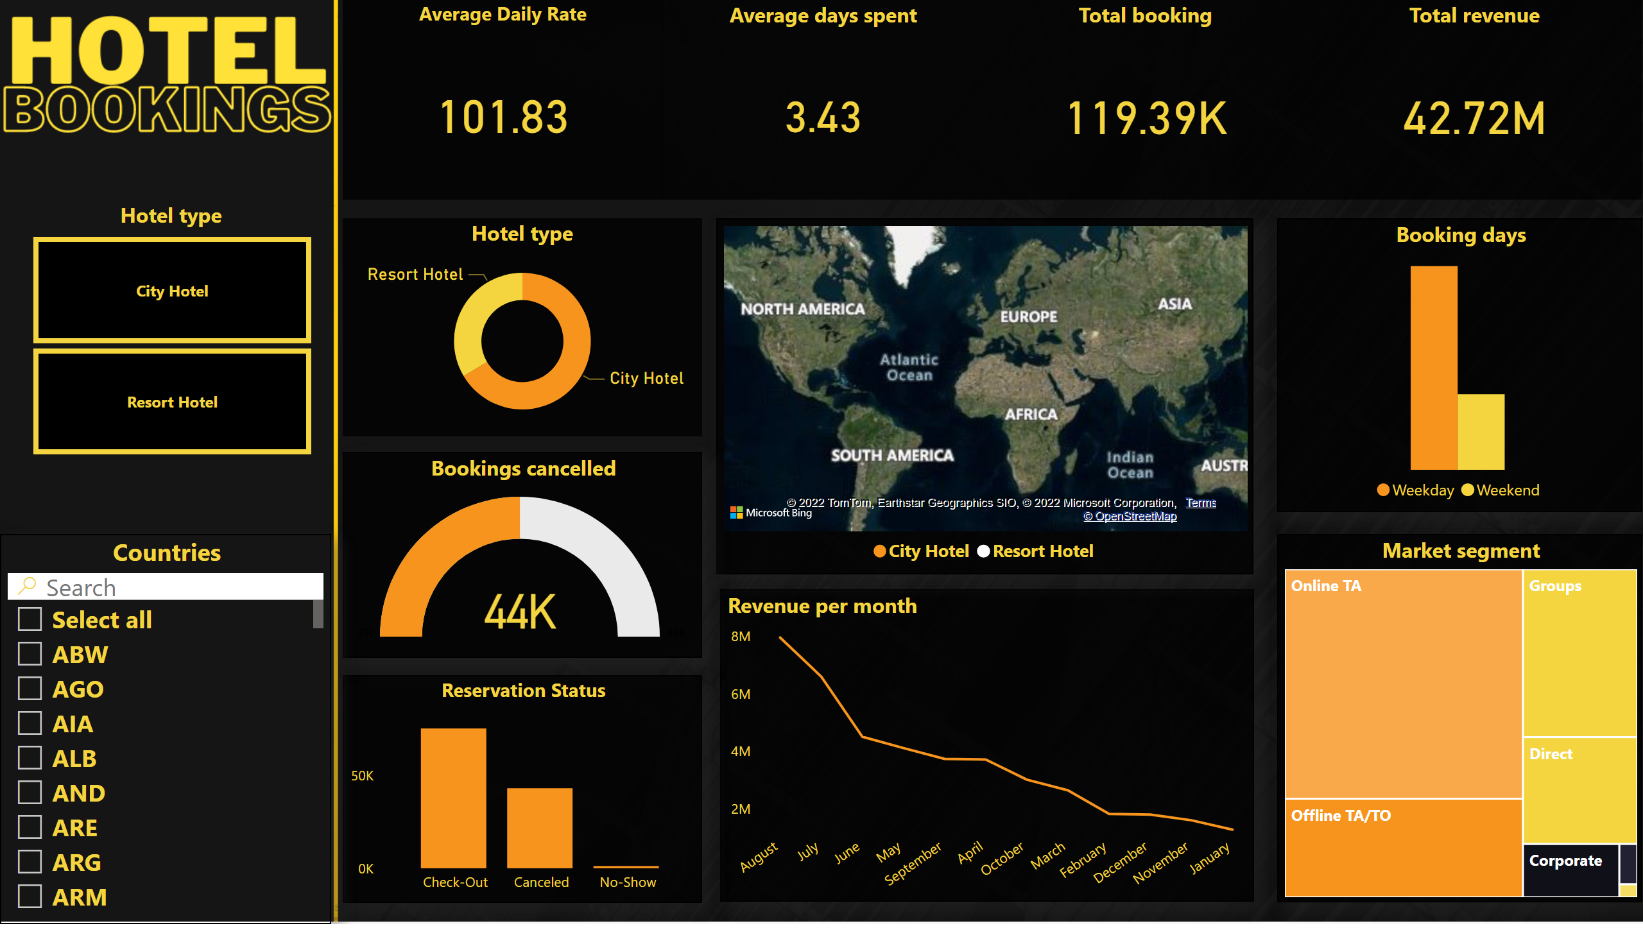
Dashboard
Notes:
Booking days
No alt text provided
Hotel type
No alt text provided
Total booking
No alt text provided
Total revenue
No alt text provided
Average Daily Rate
No alt text provided
Average days spent
No alt text provided
Market segment
No alt text provided
Revenue per month
No alt text provided
Reservation Status
No alt text provided
map
No alt text provided
Bookings cancelled
No alt text provided
Countries
No alt text provided
Hotel type
No alt text provided

Slide 8
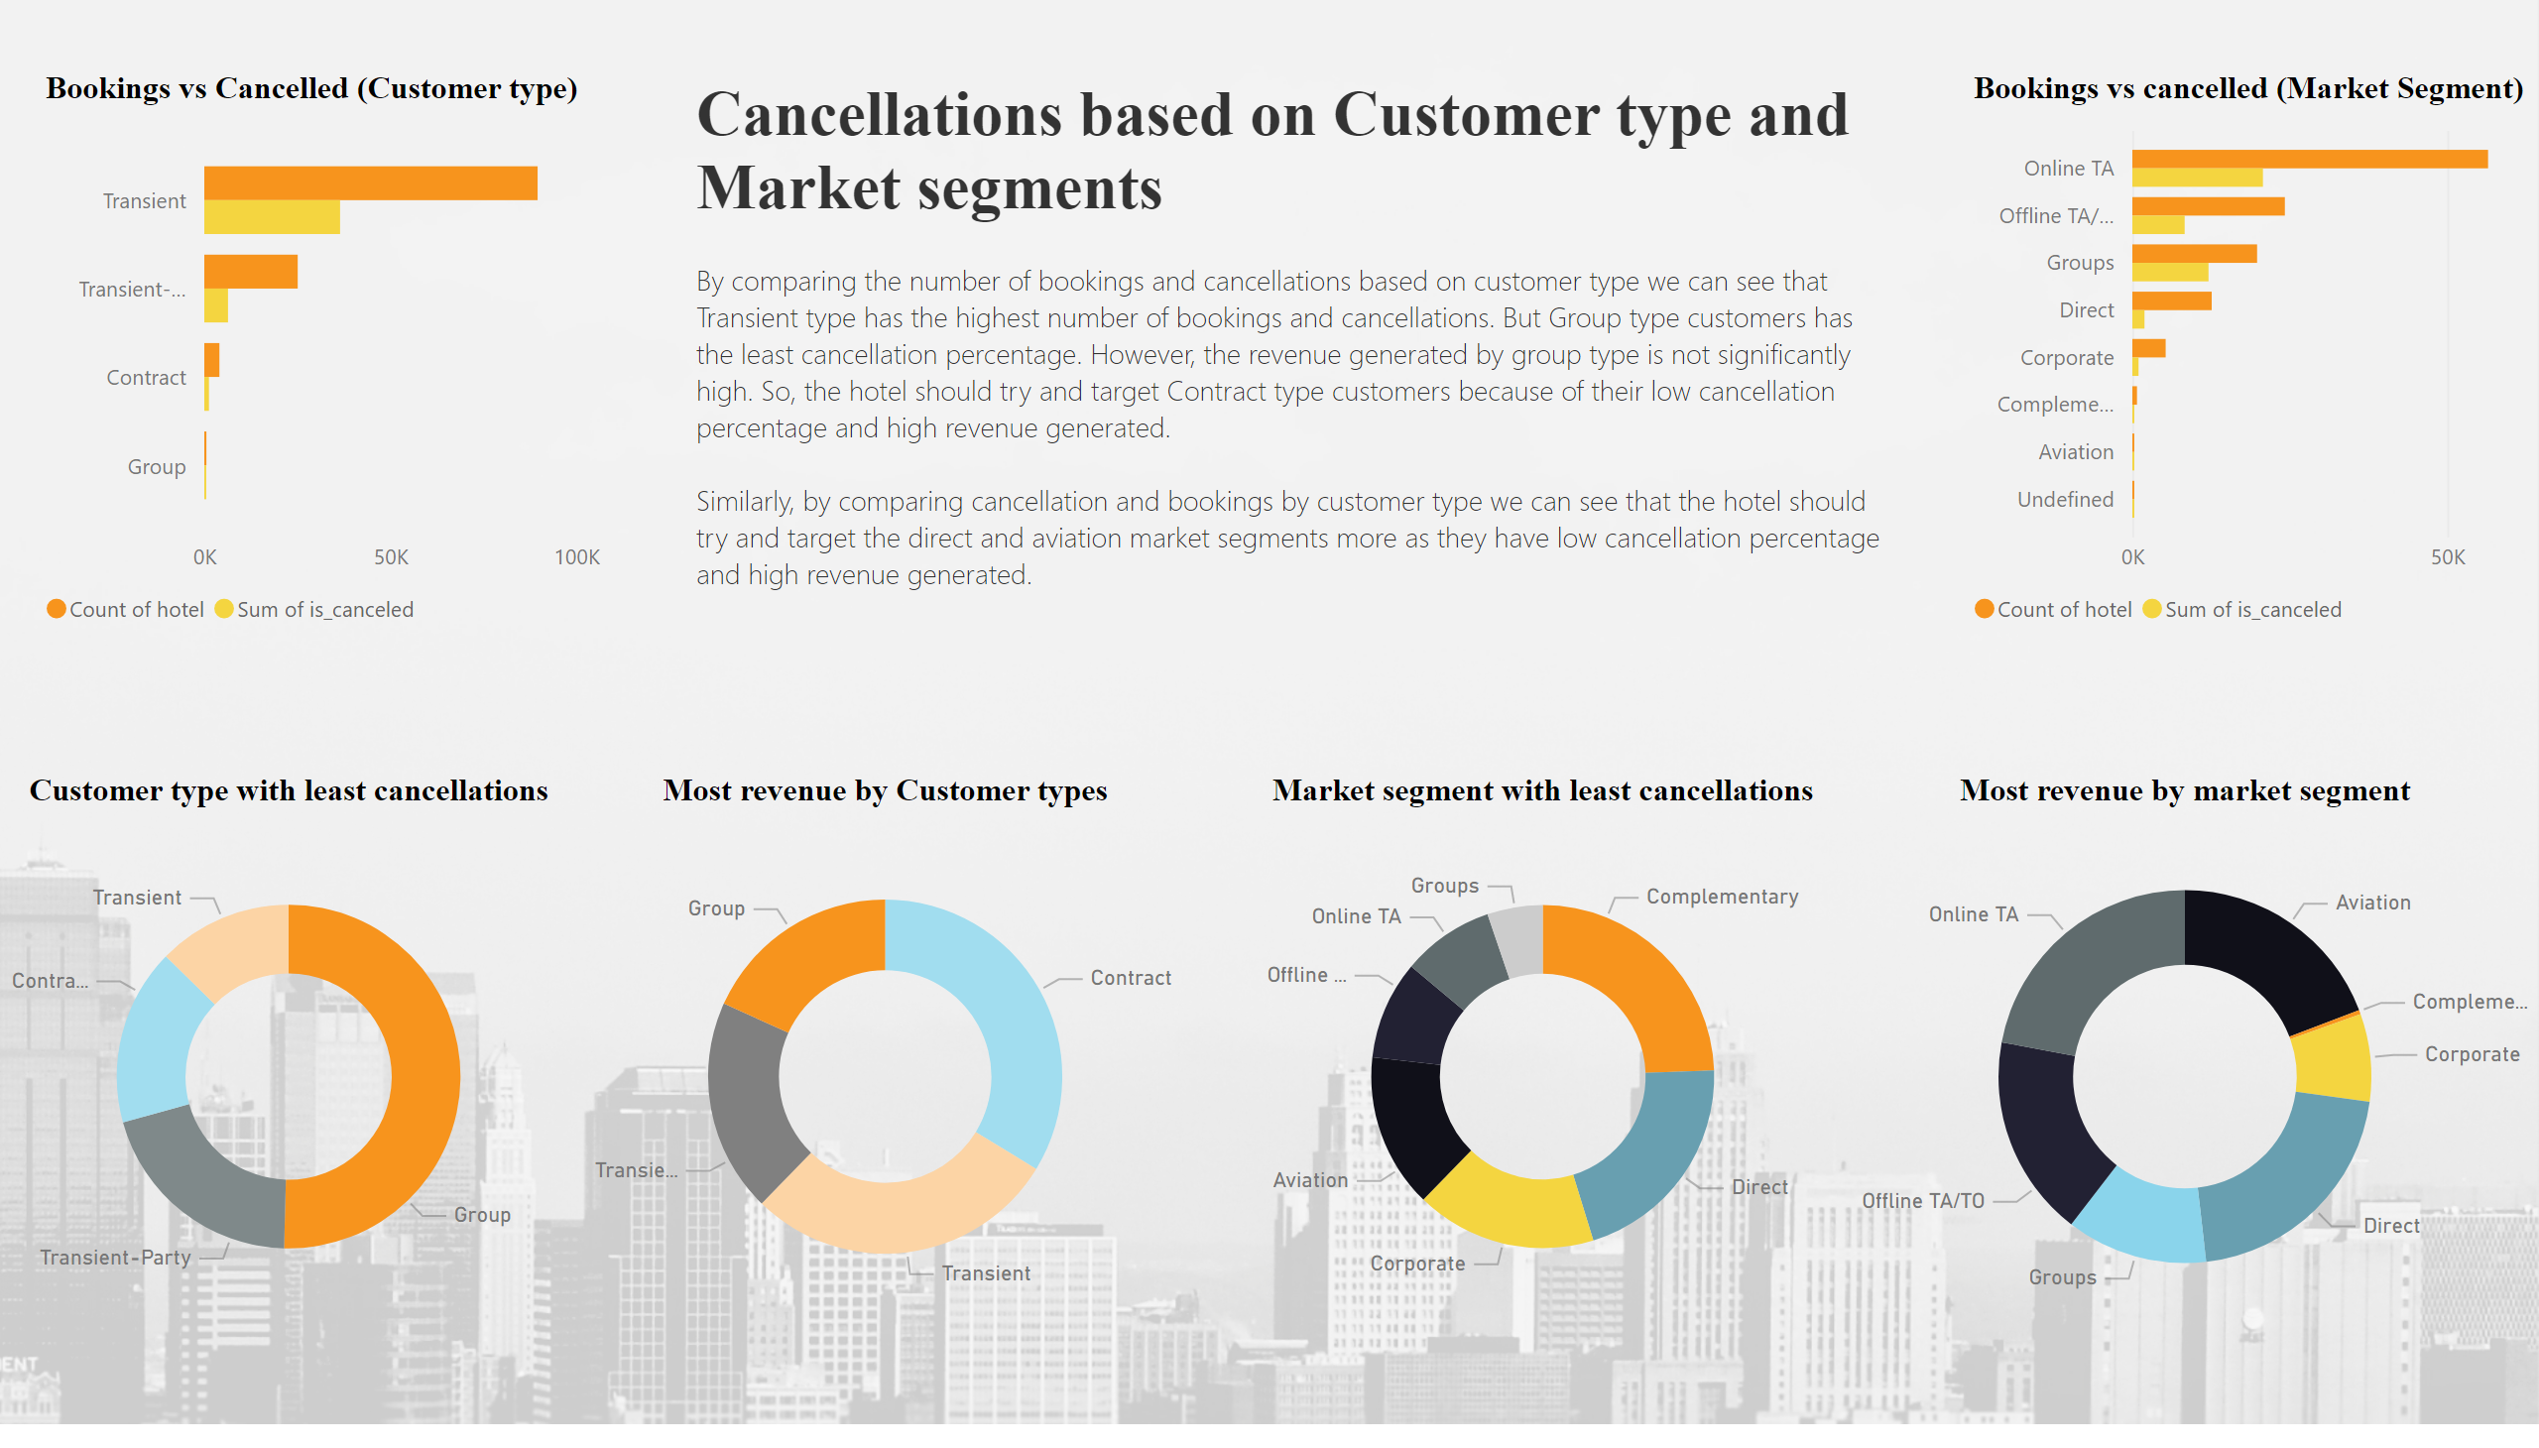
How cancellations differ by type
Notes:
Bookings vs Cancelled (Customer type)
No alt text provided
Bookings vs cancelled (Market Segment)
No alt text provided
Market segment with least cancellations
No alt text provided
textbox
No alt text provided
Most revenue by market segment
No alt text provided
Most revenue by Customer types
No alt text provided
Customer type with least cancellations
No alt text provided

Slide 9
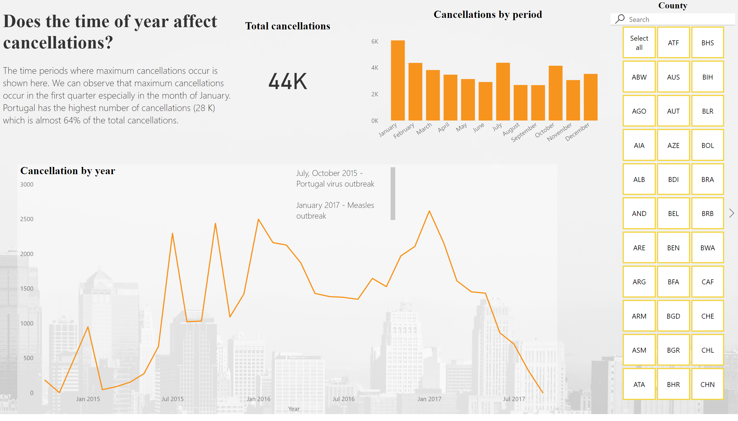
Period of Cancellation
Notes:
Cancellation by year
No alt text provided
County
No alt text provided
Cancellations by period
No alt text provided
textbox
No alt text provided
textbox
No alt text provided
Total cancellations
No alt text provided

Slide 10
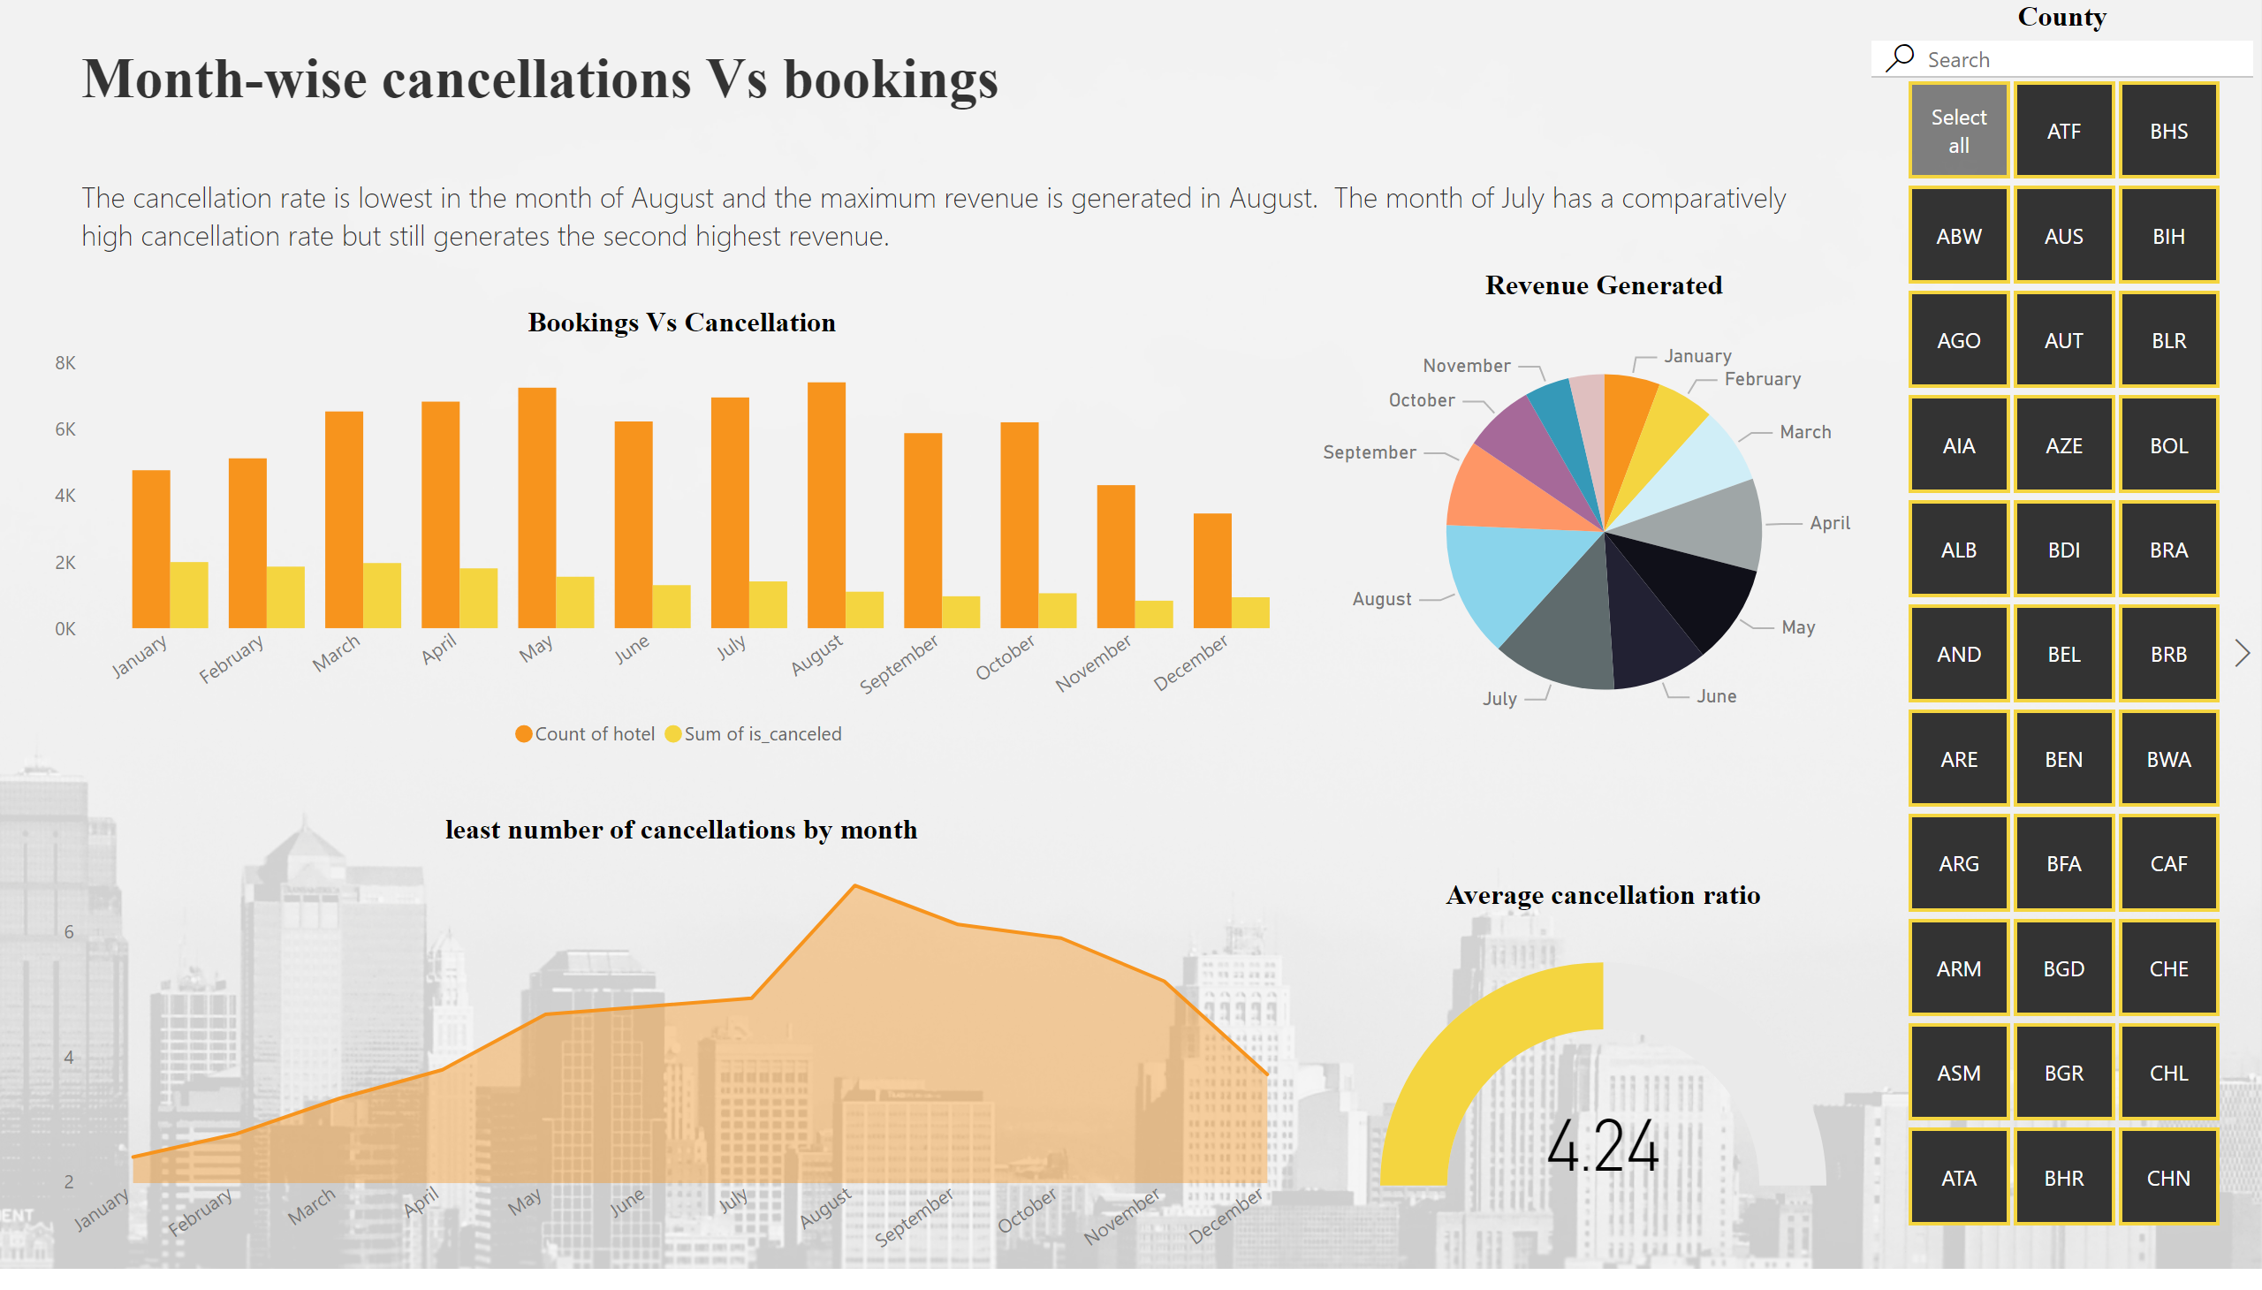
Month-wise cancellation
Notes:
Bookings Vs Cancellation
No alt text provided
least number of cancellations by month
No alt text provided
Revenue Generated
No alt text provided
County
No alt text provided
textbox
No alt text provided
Average cancellation ratio
No alt text provided

Slide 11
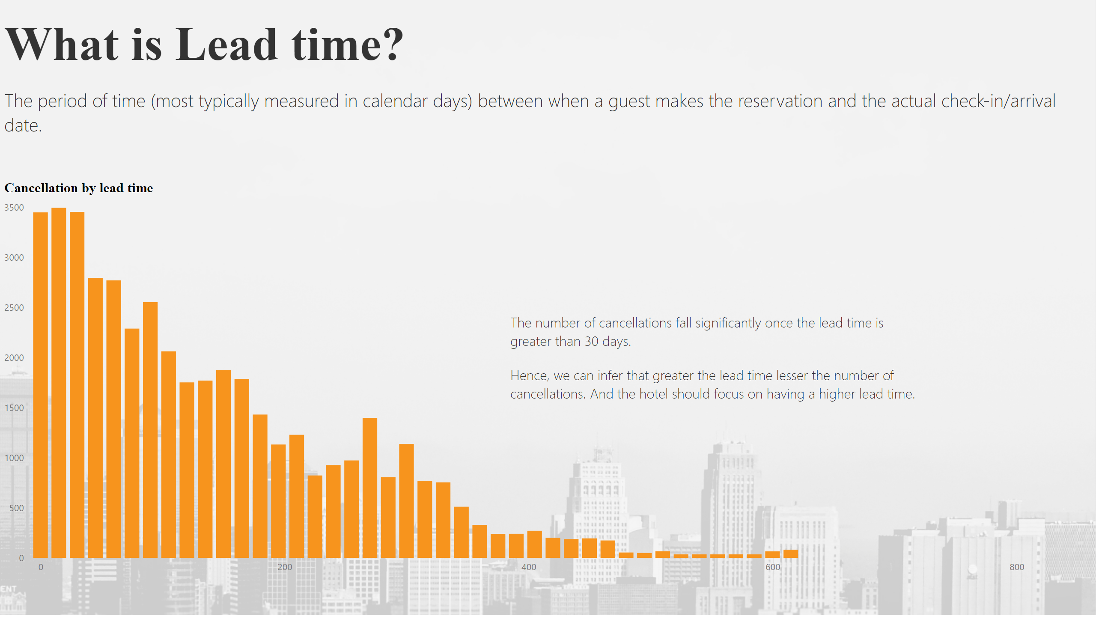
Lead time
Notes:
Cancellation by lead time
No alt text provided
textbox
No alt text provided
textbox
No alt text provided

Slide 12
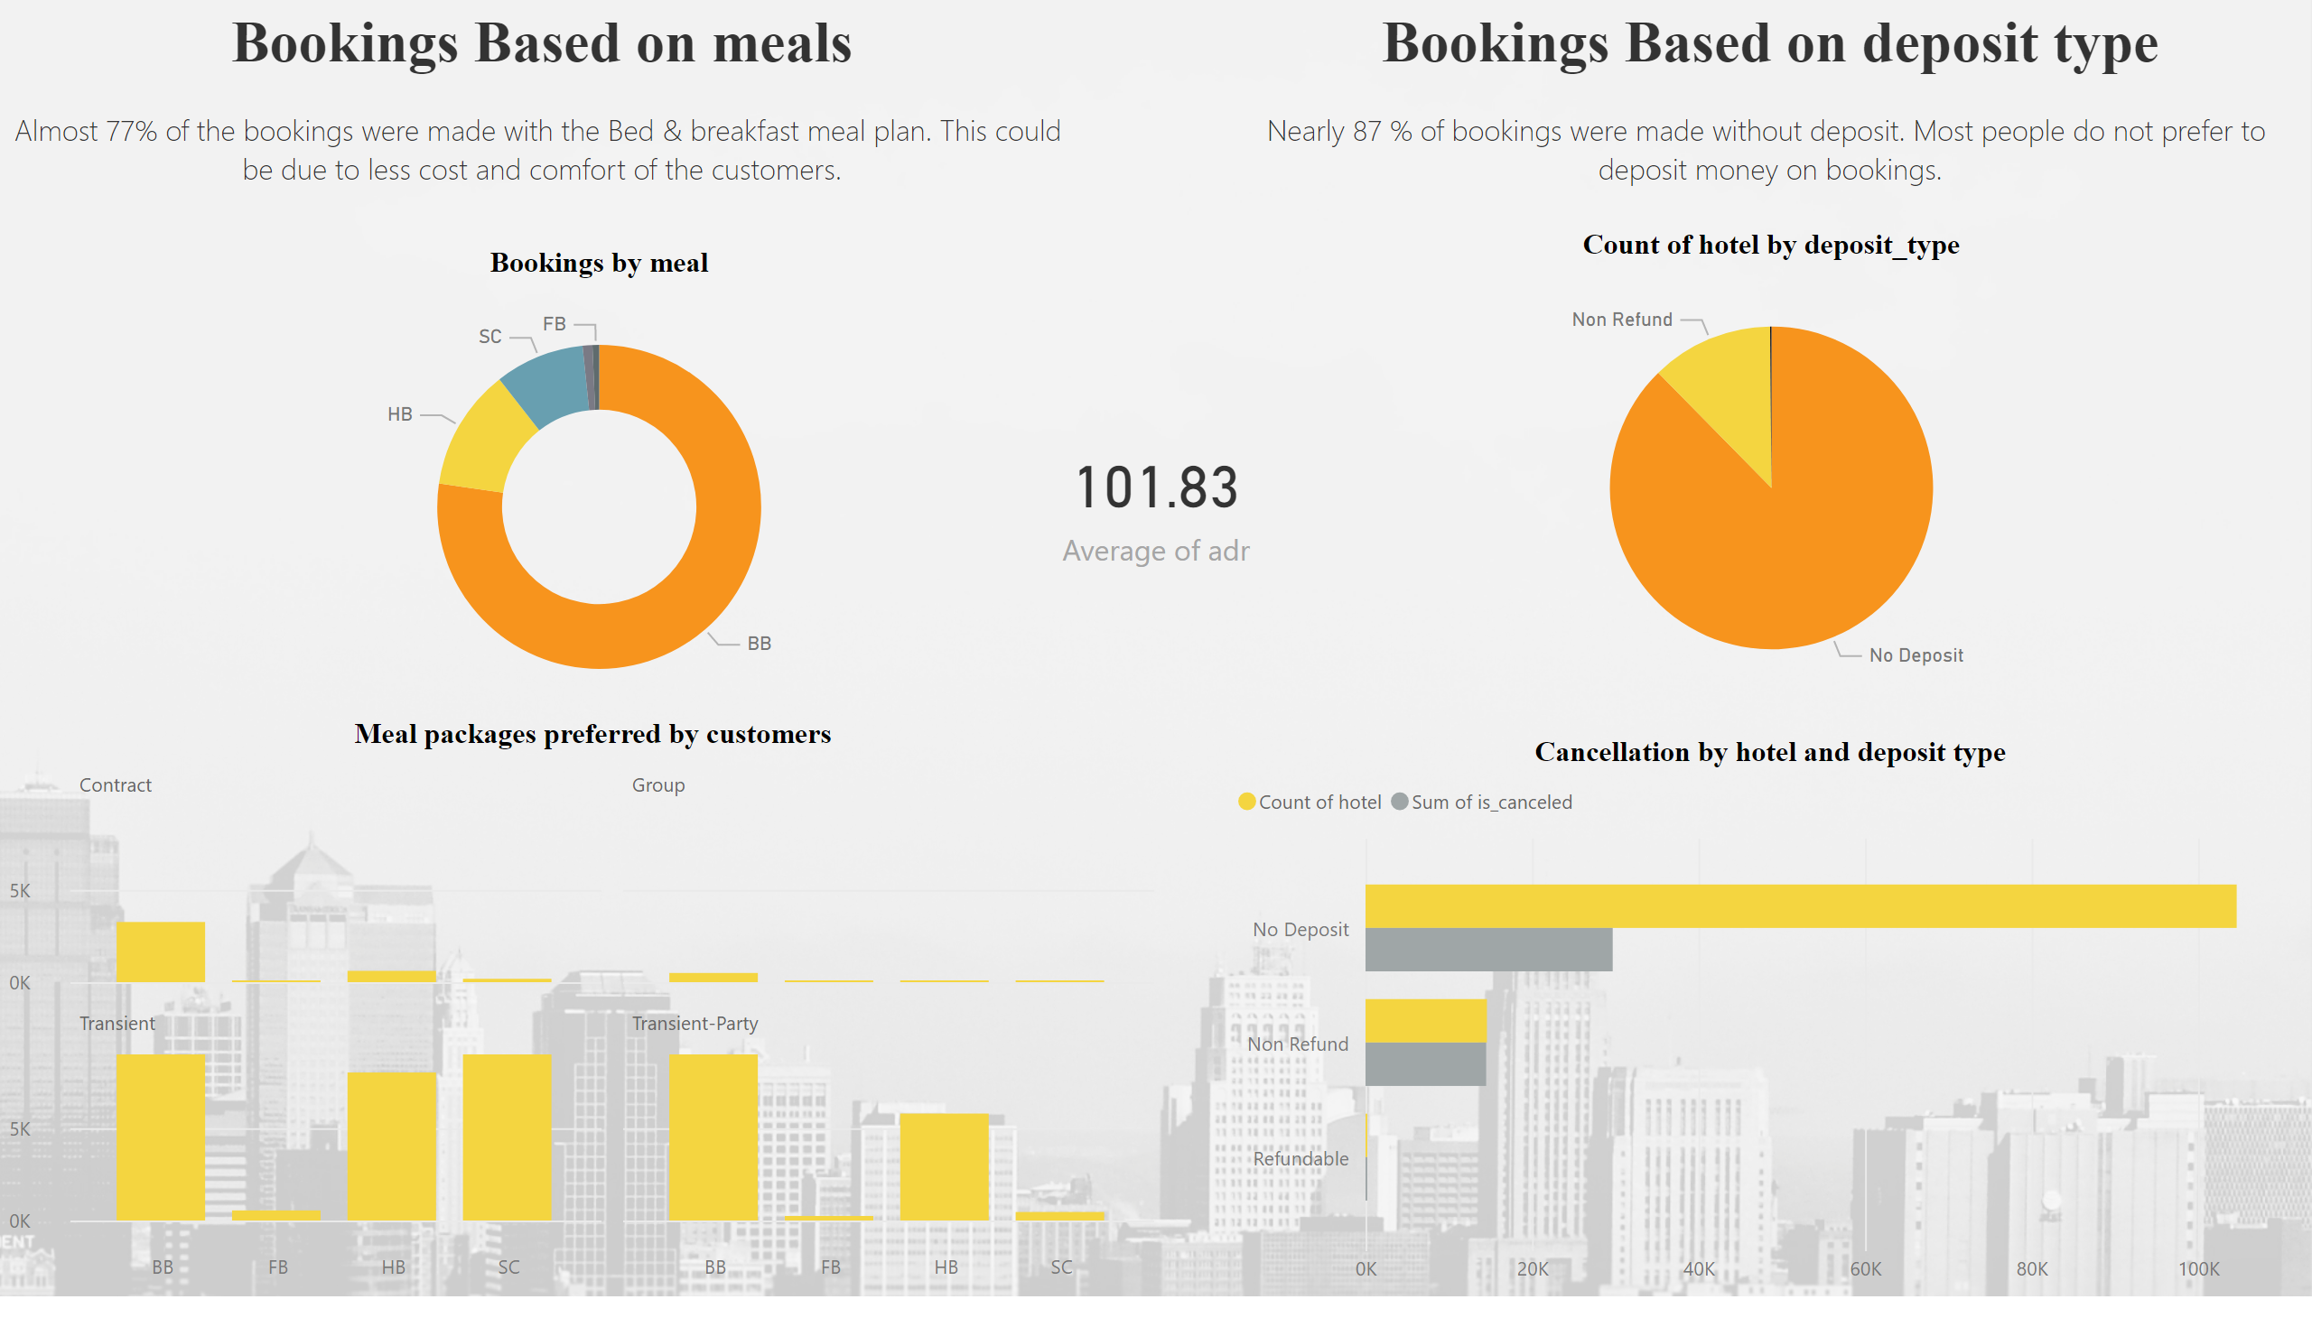
Meal
Notes:
Bookings by meal
No alt text provided
pieChart
No alt text provided
Cancellation by hotel and deposit type
No alt text provided
card
No alt text provided
textbox
No alt text provided
Meal packages preferred by customers
No alt text provided
textbox
No alt text provided

Slide 13
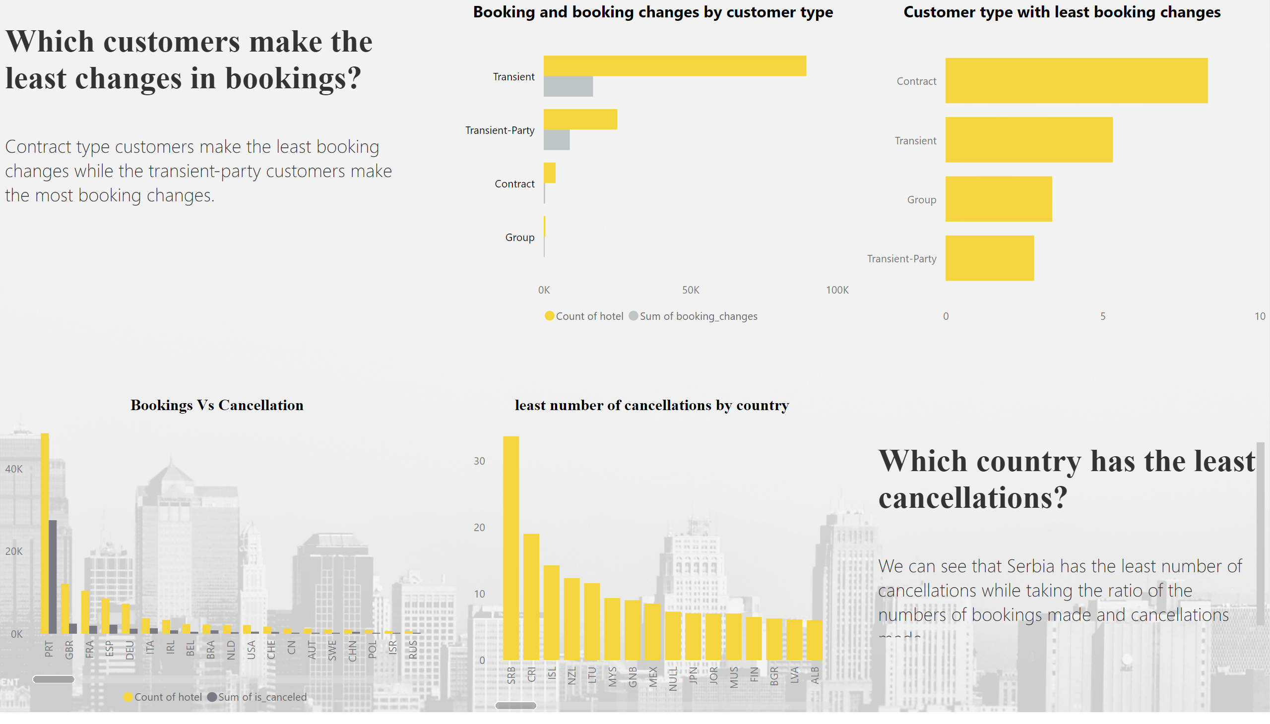
Booking changes
Notes:
Booking and booking changes by customer type
No alt text provided
Customer type with least booking changes
No alt text provided
Bookings Vs Cancellation
No alt text provided
least number of cancellations by country
No alt text provided
textbox
No alt text provided
textbox
No alt text provided

Slide 14

Insights and suggestions
Group type customers has the least cancellation percentage. However, the revenue generated by group type is not significantly high. So, the hotel should try and target Contract type customers because of their low cancellation percentage and high revenue generated.
Comparing cancellation and bookings by customer type we can see that the hotel should try and target the direct and aviation market segments more as they have low cancellation percentage and high revenue generated
By time period, we can observe that maximum cancellations occur in the first quarter especially in the month of January. Portugal has the highest number of cancellations (28 K) which is almost 64% of the total cancellations. The hotels can try and provide offer in those time periods to reduce cancellation and increase bookings.
The number of cancellations fall significantly once the lead time is greater than 30 days. The hotels should try and increase their lead time to avoid cancellations
Most customers prefer the Breakfast & bed meal plan due to the low price and comfort of the customers. A marginal hike in the B&B meal plan cost may help the hotel bring in more revenue.

Slide 15

Acknowledgements
The data is originally from the article Hotel Booking Demand Datasets, written by Nuno Antonio, Ana Almeida, and Luis Nunes for Data in Brief, Volume 22, February 2019.
https://www.kaggle.com/datasets/jessemostipak/hotel-booking-demand
https://www.who.int/emergencies/disease-outbreak-news/item/17-september-2015-wnv-en

Slide 16


